Slide 1
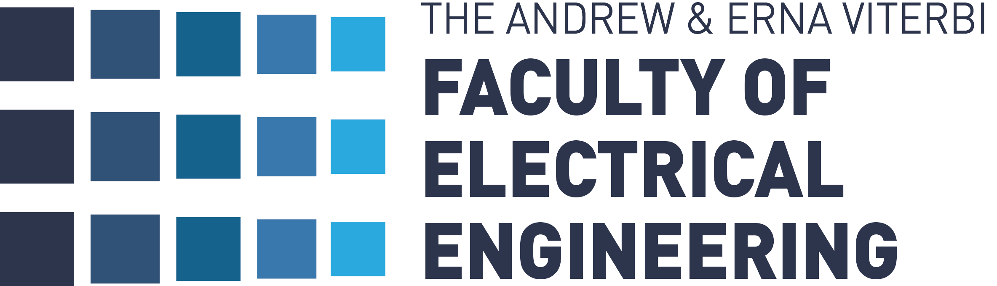

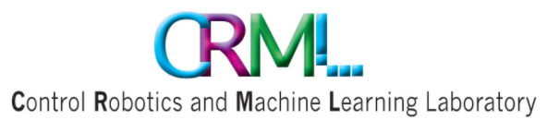
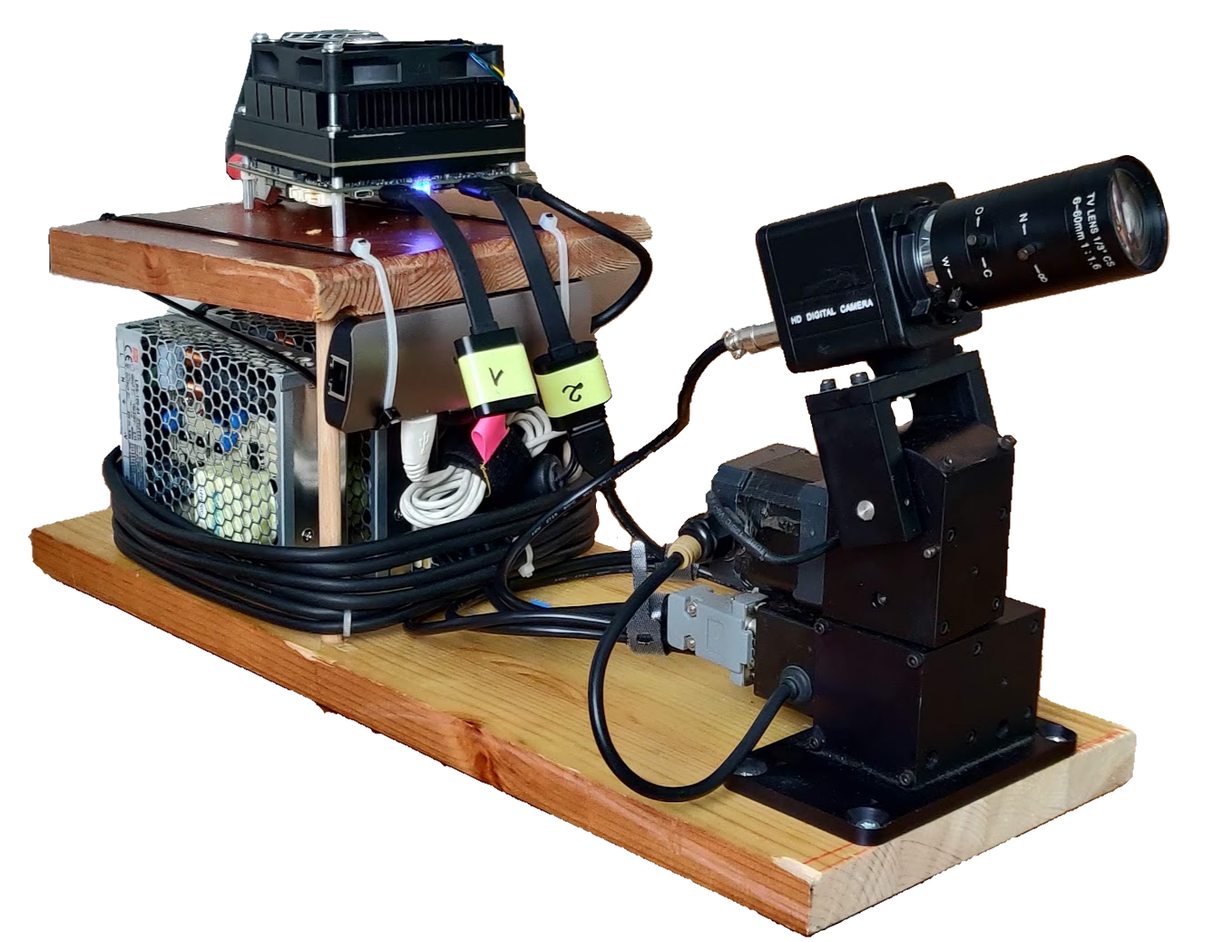
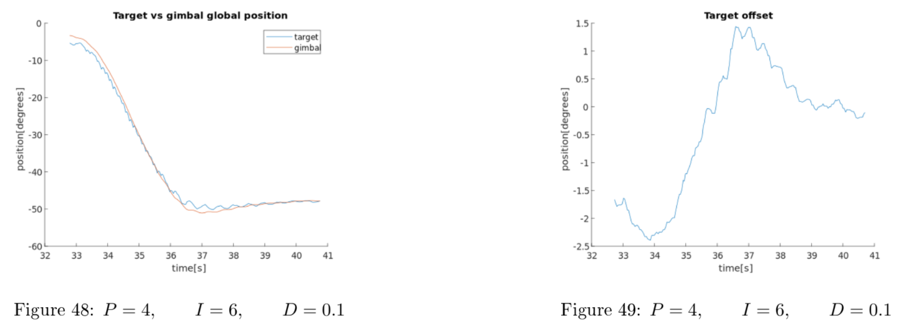
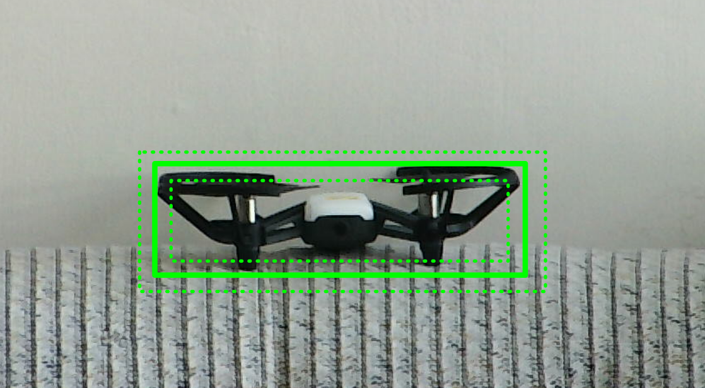
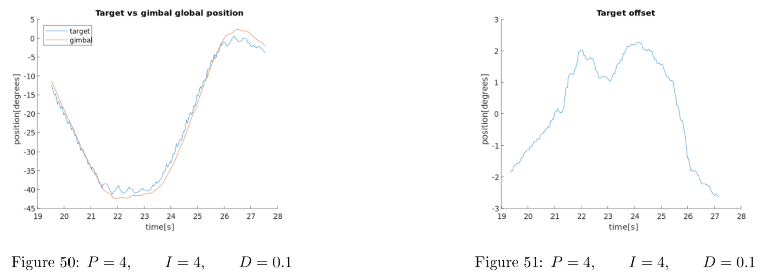
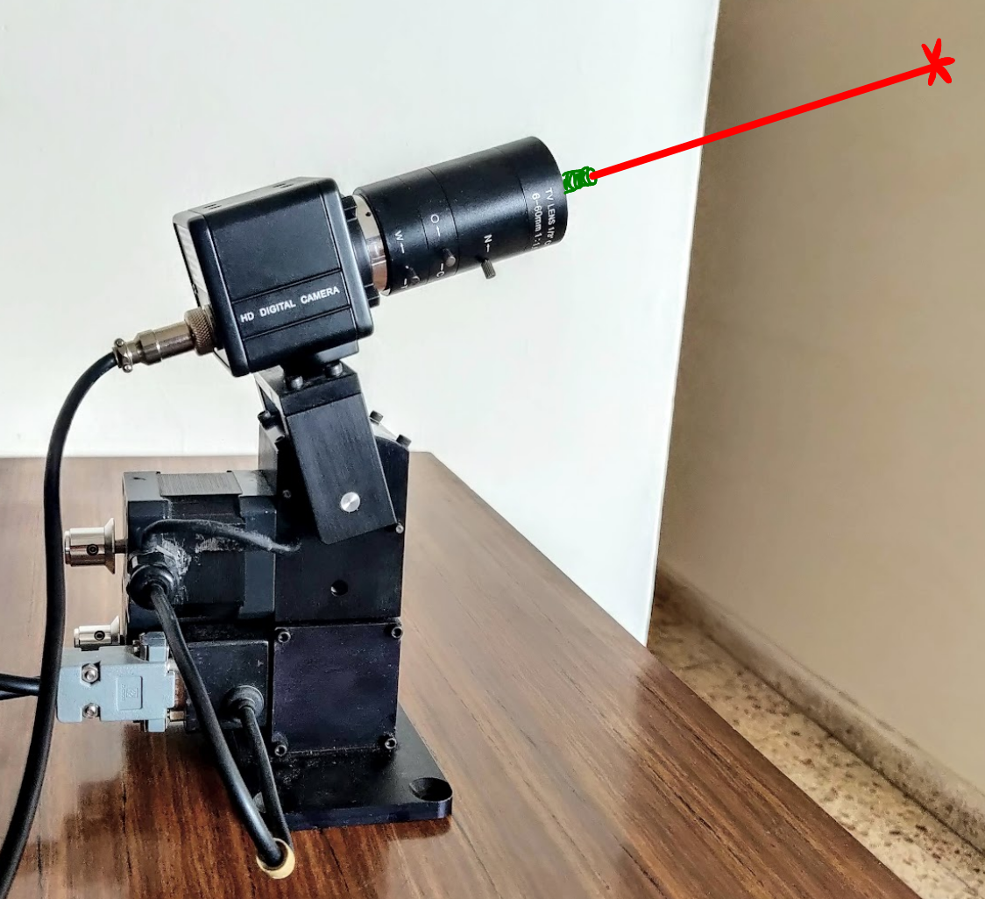
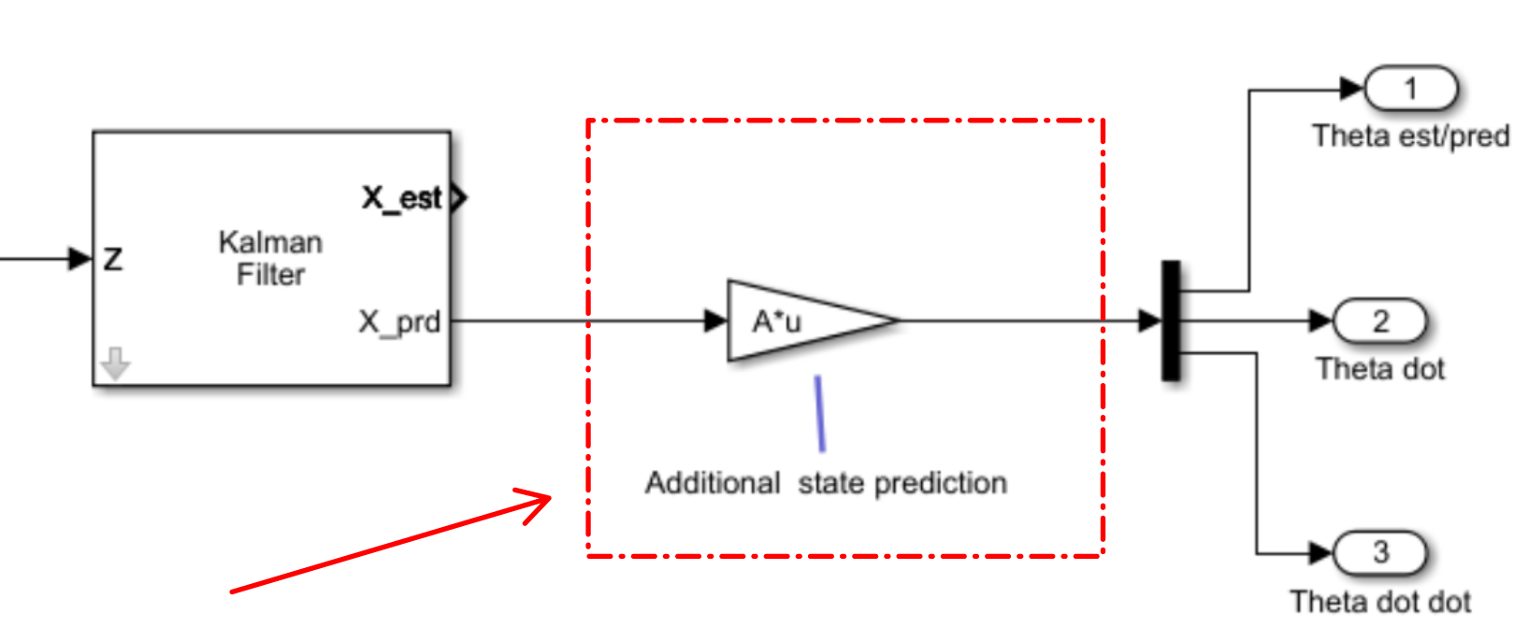
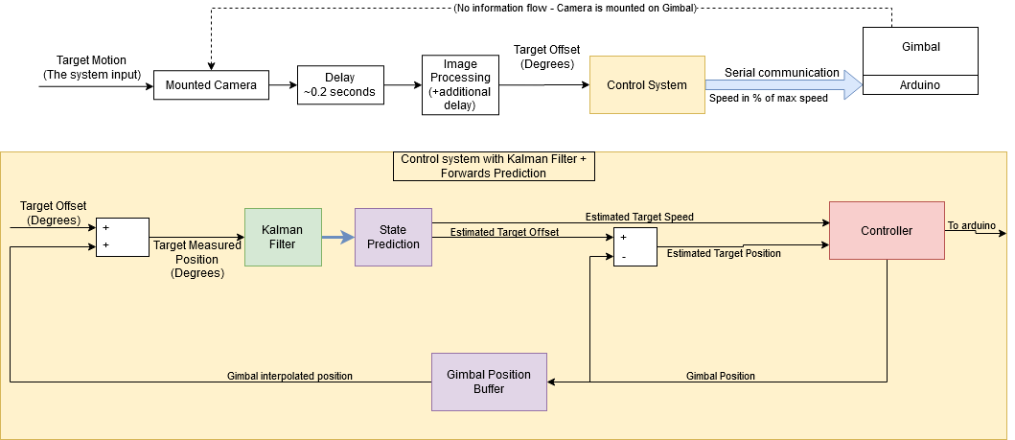
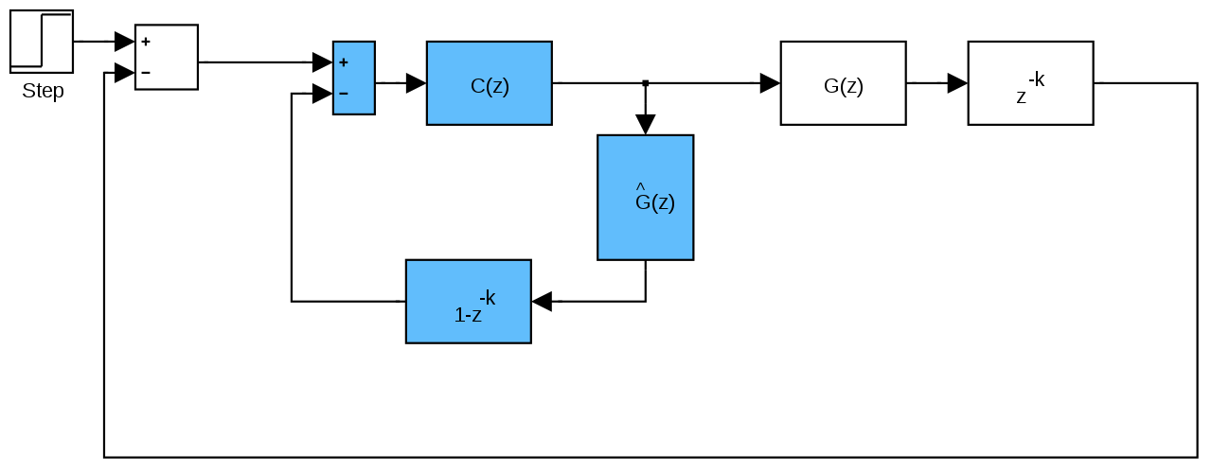

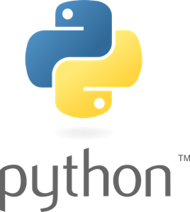
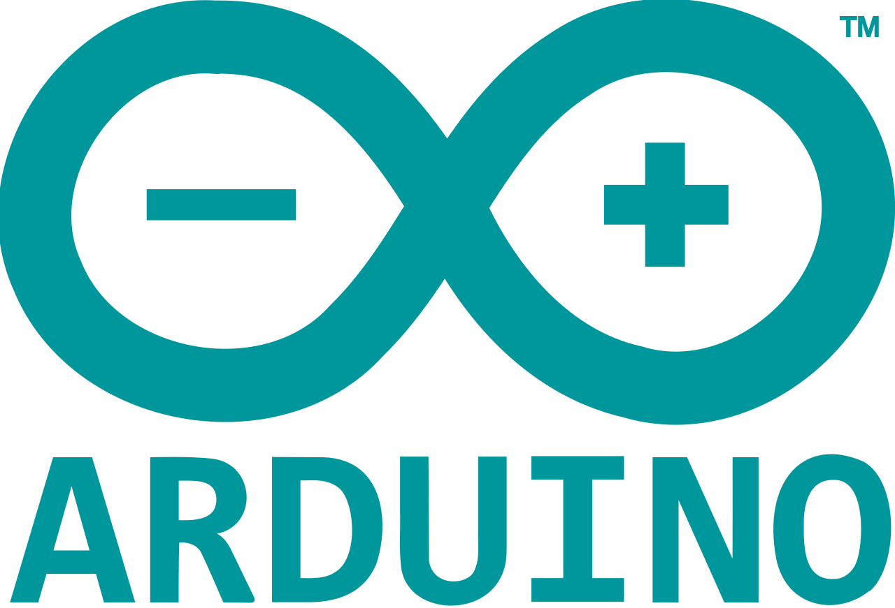
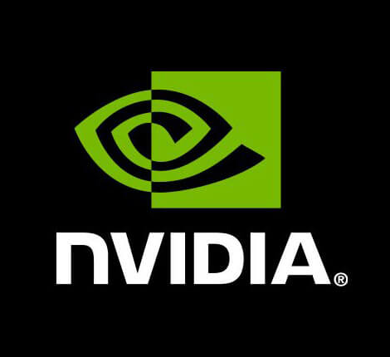
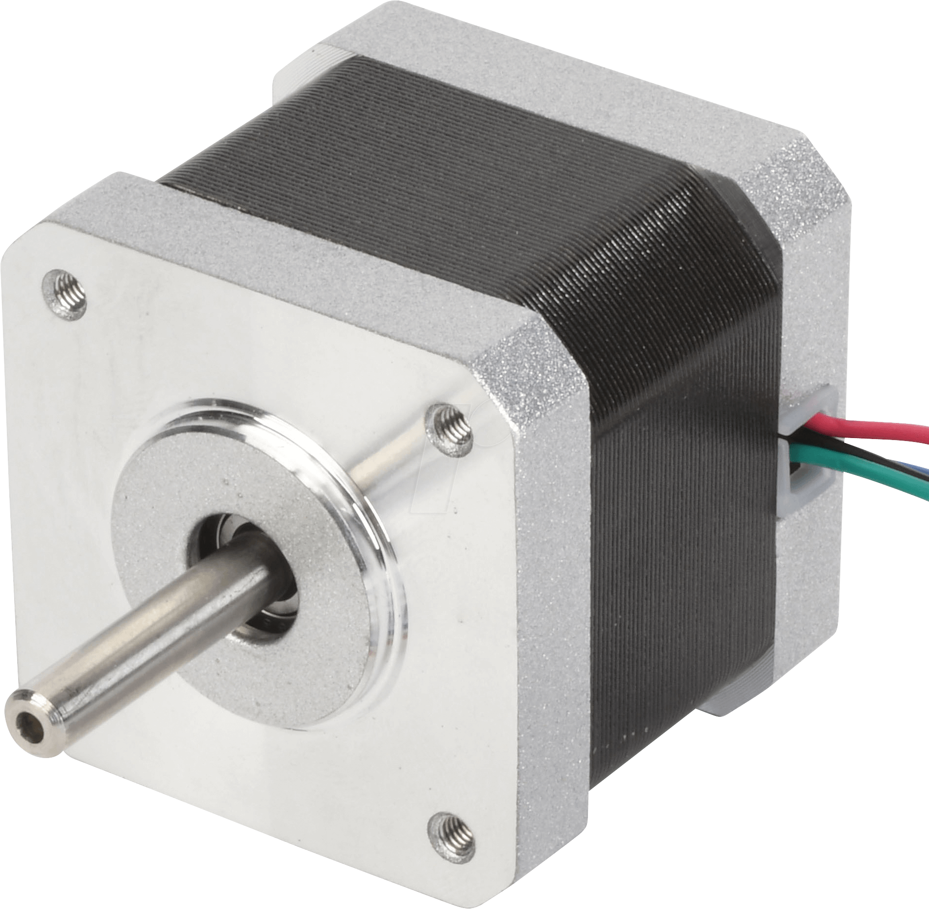
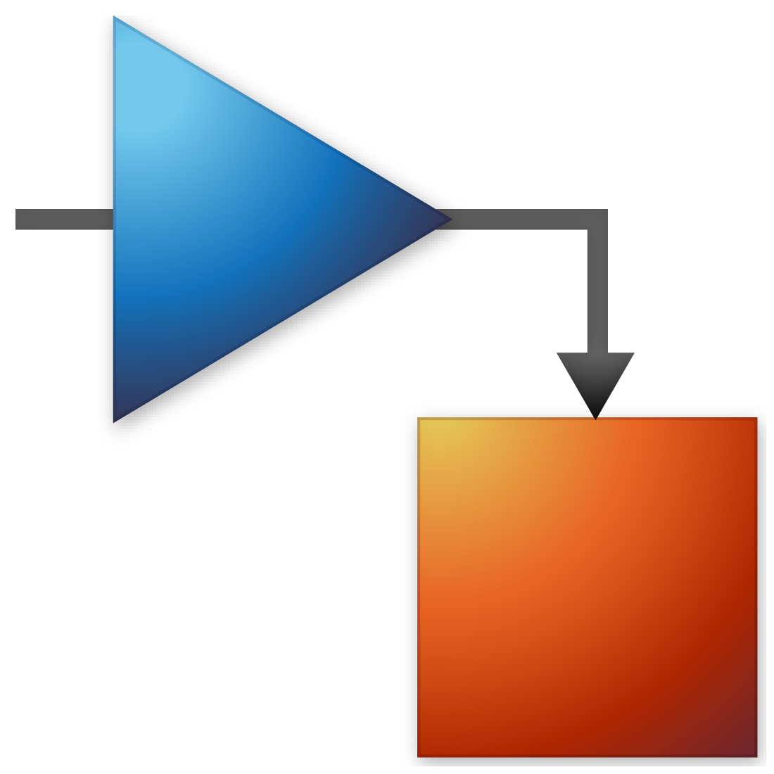

Controlling A Gimbal to Follow A Drone, Handling Input Delay with Prediction
A work by Amir Sarig, Idan Anner, supervised by Ilan Rusnak at CRML Laboratory, Technion Institute of Technology, October 2020
Introduction
Our system consists of a camera mounted on an open-loop stepper pan & tilt unit. The camera captures a frame and feeds it to a DNN, which gives us the pixel coordinates of a drone within it. These coordinates are the input to our system, and our goal is to control the motors so that the target is centered in the camera.
Results
Below are some examples of real-life experiments. The next graph logs the following performance of a ramp motion profile.
The next graph describes a back and forth ramp motion profile:
Handling Long Input Delay
Our camera suffers from ~0.17s E2E (input) delay causes 2 suveer problems:
Target position is based on target offset and gimbal position. As only the offset is affected by the delay, the target position we calculate is false, and not even delayed as we expect.
Even if our target position is known, it is delayed and so the gimbal follows the target in delay
Improve performance using Forward Prediction:
We add an artificial delay on the gimbal position, so we get a correct target position (but still delayed)
We predict the position of the target based on its motion
Implementing a good target following system may be useful for various applications such as:
recording fast moving object like birds, bats or insects.
Shooting down military invasive targets
Maintaining beam based communication with a moving system
These graphs were captured by using the best PID values we have found and they present good targeting performance.
The Control
Conclusions
Working on this project had lead us to the following insights:
Input delay is the bottleneck for good following performance in this project
It cannot be fully overcome using prediction
It’s affect is amplified with higher types of the system
Working with open-loop system is complex and can cause inaccuracy
Relying on relative input value is less stable than absolute input value
Simulating a code-based system is not always trivial, at least with Simulink
Performing real-life experiments might involve additional challenges and additional noise
Traditional Kalman Filter is not suited for compex motion profiles
Our control loop, written in Python includes:
Kalman Filter
PID Controller
Predictor
As an adaptation to what is commonly done with in-system delays (Smith predictor):
It takes into account::
Discrete, variable frame rate
Discrete motor step size
Open-Loop Control
Software & Hardware delays
Video

